Slide 1
Building Applications with Freestyle Projects

Slide 2




Anatomy of the Build
Workspace Folder
Git Repo
Clean
Compile
Test
Package

Slide 3
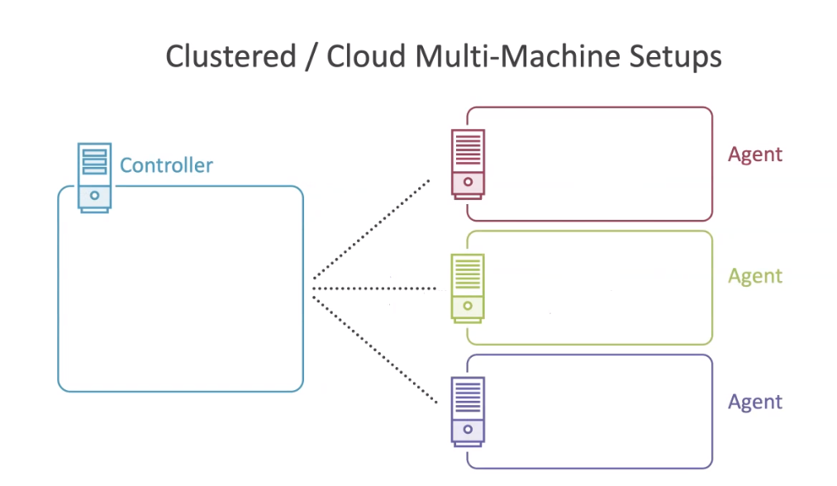

Slide 4











Manual -> Jenkins
Workspace Folder
Git Repo
Clean
Compile
Test
Package

Slide 5
Workspaces are Temporary

Slide 6
Artifacts are Forever

Slide 7







Anatomy of the Build
Workspace Folder
Git Repo
Clean
Compile
Test
Package

Slide 8

Anatomy of the Build
Workspace Folder
Git Repo
Clean
Compile
Test
Package

Slide 9
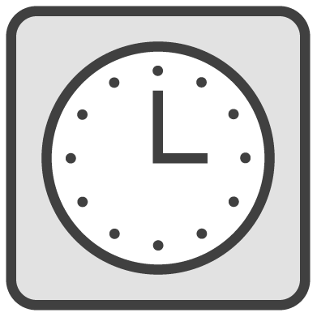
Anatomy of the Build
Workspace Folder
Git Repo
Clean
Compile
Test
Package

